Slide 1
The history of computer storage

Slide 2
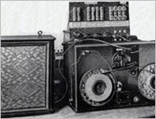
1928
Magnetic Tape
Fritz Pfleumer, a German engineer, patented magnetic tape in 1928. He based his invention on Vlademar Poulsen's magnetic wire.

Slide 3
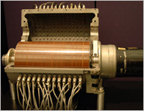
1932
Magnetic Drum.
G. Taushek, an Austrian innovator, invented the magnetic drum in 1932.
He based his invention on a discovery credited to Fritz Pfleumer.

Slide 4

1950
Magnetic Core.
A magnetic core memory, also known as a ferrite-core memory, uses small magnetic rings made of ceramic to store information from the polarity
to the magnetic field.

Slide 5

1956
Hard disk
A hard disk implements rotating platters, which stores and retrieves bits of digital information from a flat magnetic surface.

Slide 6
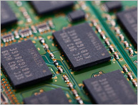
1966
DRAM
In 1966, Robert H. Dennard invented DRAM (Dynamic Random Access Memory) cells. Memory cell is contained in one transistor. DRAM cells store bits of information as an electrical charge in a circuit and increase overall memory density.

Slide 7
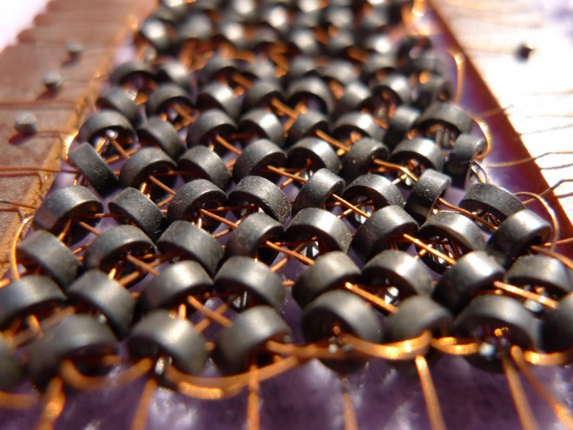
1968 Twistor Memory
Bell Labs developed Twistor memory by wrapping magnetic tape around
a wire that conducts electrical current. Bell Labs used Twistor tape between 1968 to the mid-1970s before it was totally replaced by RAM chips.

Slide 8
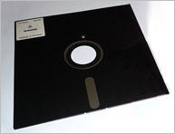
1971 8" Floppy
IBM started its development of an inexpensive system set on loading microcode into the System/370 mainframes. As a result, the 8-inch floppy appeared. A floppy disk is a portable storage device made of magnetic film applied onto plastic.

Slide 9
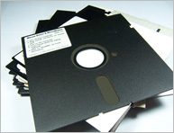
1976 5.25" Floppy
Allan Shugart developed a the 5.25-inch floppy disk in 1976 because the 8-inch floppy was too large for standard desktop computers. The 5.25-inch floppy disk had a storage capacity of 110 -360 kilobytes and were cheaper and faster.

Slide 10
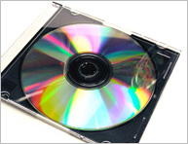
1980 CD
During the 1960s, James T. Russel thought of using light to record and replay music. he invented the optical digital television recording and playback television in 1970. In 1975, Philips representatives visited Russel at his lab and paid Russel millions for him to develop the compact disc (CD). In 1980, Russel completed the project.

Slide 11
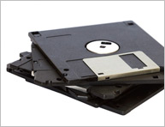
1981 3.5" Floppy
The 3.5-inch floppy disk had significant advantages over its previous versions. It had a metal cover that made it harder to damage the magnetic film inside. The 3.5-inch floppy disk had a storage capacity of 1.44 megabytes.

Slide 12
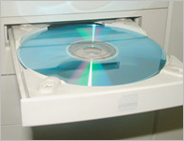
1984 CD ROM
The CD-ROM, also known as the Compact Disk Read-Only Memory, used the same physical format as the audio compact disks to store digital data. The CD-ROM encodes small pits of digital data into the lower surface of the plastic disc.

Slide 13
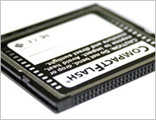
1994 Compact Flash
Compact Flash (CF), also known as “flash drives”, used flash memory
in a disc to save digital data. CF devices are used in digital cameras and computers to store digital information.

Slide 14

1995 DVD
DVD became the next generation of digital disc storage. DVD, a bigger and faster alternative to the compact disc, serves to store multimedia data. Its capacity was 4.7GB.

Slide 15
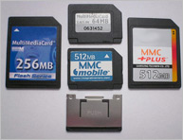
1997 Multimedia Card
The Multimedia Card (MMC) uses a flash memory card standard to house digital data. It was introduced by Siemen's and SanDisk in 1997.

Slide 16
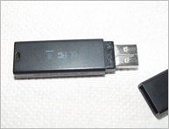
1999 Microdrive
A USB Flash Drive uses a NAND-type flash memory to store digital data.
A USB Flash Drive plugs into the USB interface on standard computers.

Slide 17
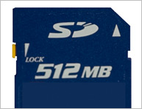
SD Card 2000
The Secure Digital (SD) flash memory format incorporates DRM encryption features that allow for faster file transfers. A typical SD card stores digital media for a portable device.

Slide 18
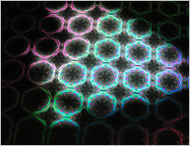
Holographic MEMORY
The future of computer memory relies on holographic technology. It can store digital data at high density inside crystals and photo-polymers.
The advantage of holographic memory lies in its ability to store data in whole crystals (3D), instead of just on the surface of discs.

Slide 19

Cloud Backup Solutions
Cloud enables businesses to protect data using backup, recover from a disaster, and archive files on the Internet.

